Slide 1
Getting started with JavaScript
Mirzoulugbek Yusupov

Slide 2
What is ECMAScript (ES)?
ECMAScript (ES) is a standardized scripting language specification maintained by ECMA International.
JavaScript follows ECMAScript standards to ensure compatibility across different environments.
First release: 1997 (ES1)
Major Versions:
ES5 (2009): Added strict mode, JSON support.
ES6 (2015): Introduced let, const, arrow functions, classes, promises, etc.
ES7 - ES2024: Regular updates with new features.
ECMAScript defines rules, but JavaScript is the implementation!

Slide 3

What is JavaScript?
A high-level, interpreted programming language.
Created by: Brendan Eich in 1995.
Purpose: Adds interactivity to web pages.
Runs on: Browsers and servers (Node.js)
Interpreted & Just-In-Time Compiled (executes code line by line)
Dynamically Typed (No need to declare variable types)
Prototype-Based (Uses object prototypes instead of classes)
Single-Threaded but Asynchronous (Uses event loops & promises)

Slide 4
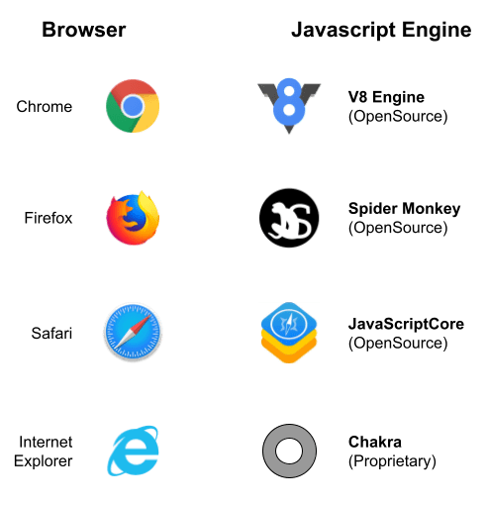
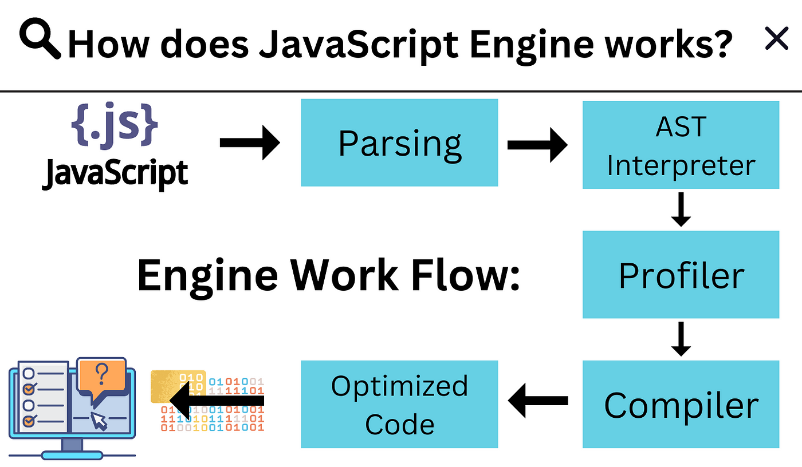
JavaScript Engines
A JavaScript Engine is a program that interprets / converts JS code into machine code for execution

Slide 5
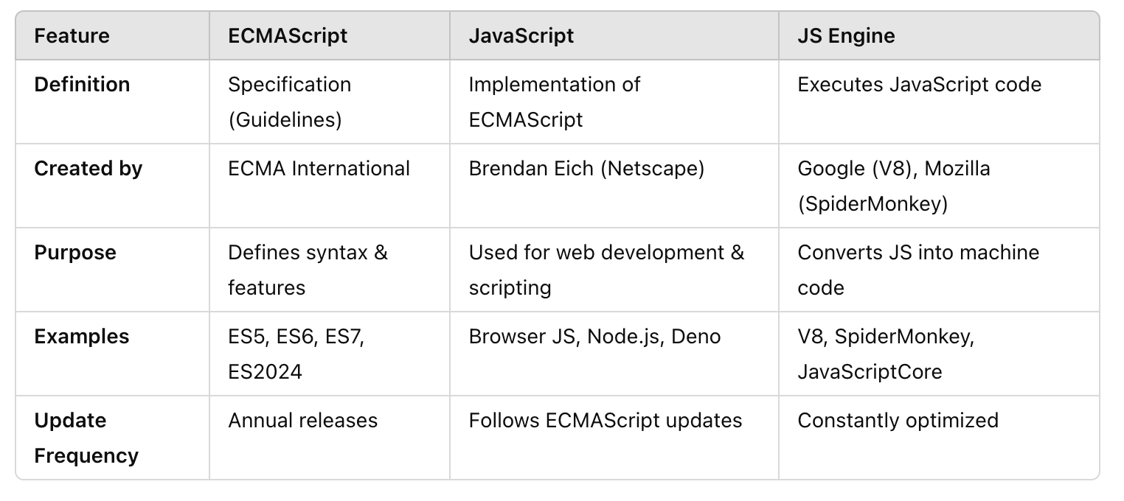
ECMAScript, JavaScript & JS Engines

Slide 6
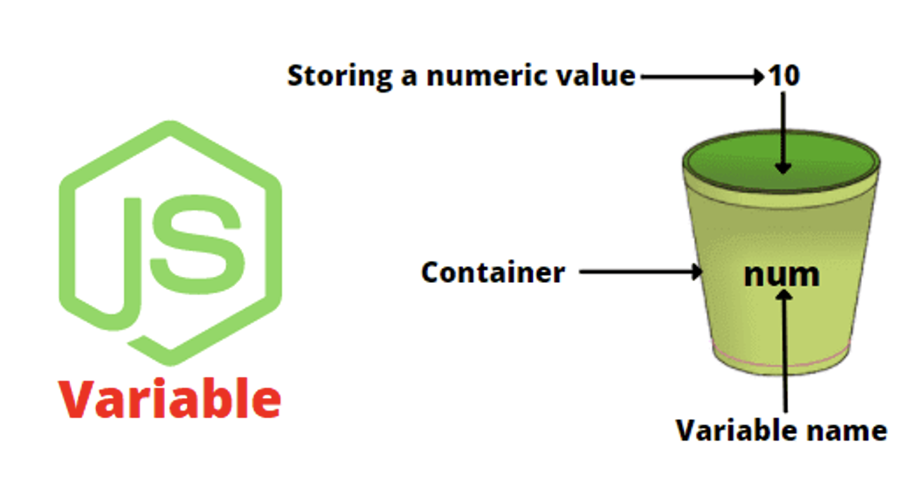
Variables and Data Types
Variables are containers for storing data values.
In JavaScript, var, let, and const are used to declare variables, but they have key differences in terms of scope, re-declaration, and mutation.
var: Function-scoped, can be re-declared and updated
let: Block-scoped, cannot be re-declared.
const: Block-scoped, cannot be re-assigned.

Slide 7
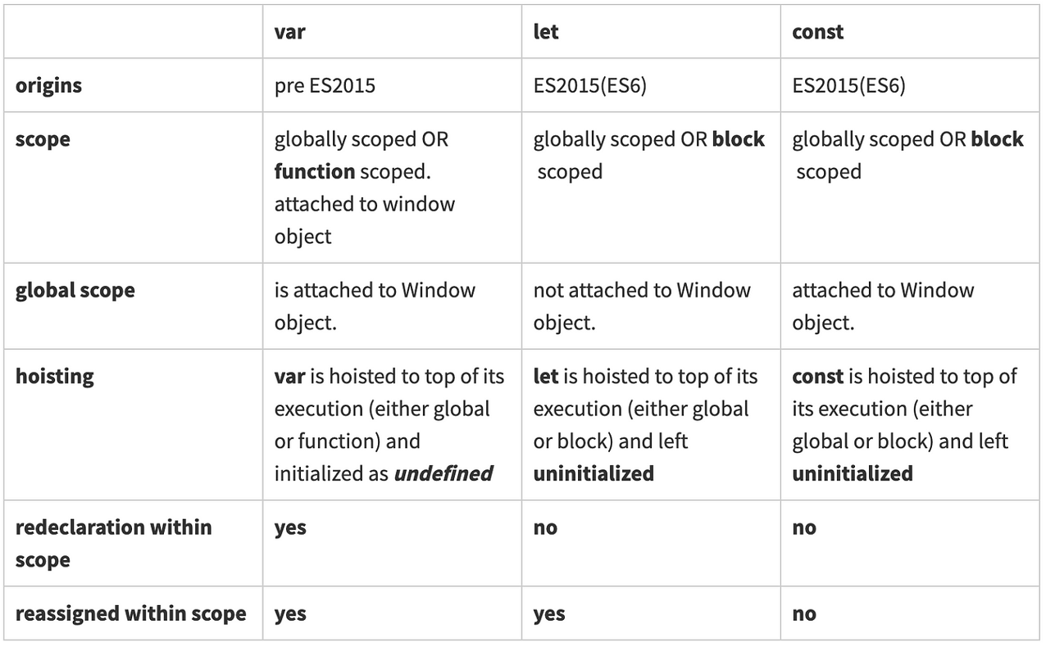
var vs let vs const
TDZ
emporal
ead
one

Slide 8


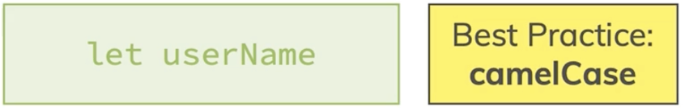
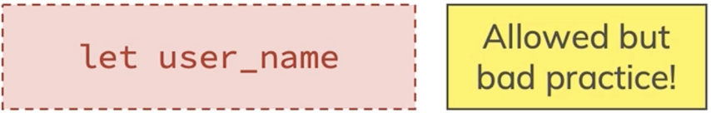
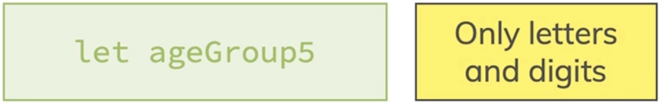
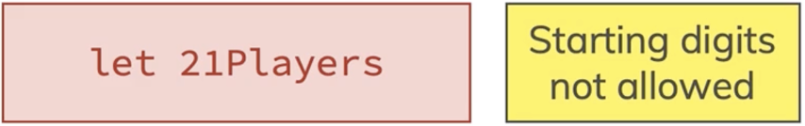
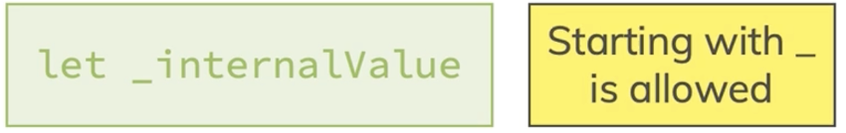

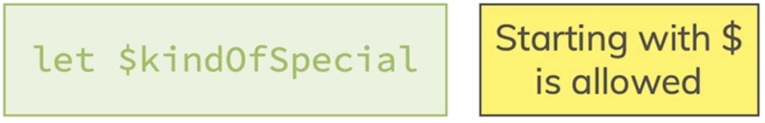

Naming variables

Slide 9
Primitive vs Reference
Data Types
Primitive
Reference
Numbers
Strings
Boolean
Objects
Functions
Null
Undefined
Arrays

Slide 10
Coercion and Conversion
Type Coercion (Implicit Conversion)
Type coercion happens automatically when JavaScript converts a value from one type to another during operations.
Type Conversion (Explicit Conversion)
Type conversion is when you manually change a data type using JavaScript functions.
+ prefers string concatenation, converting numbers to strings.
-, *, and / prefer numeric operations, converting strings to numbers.

Slide 11
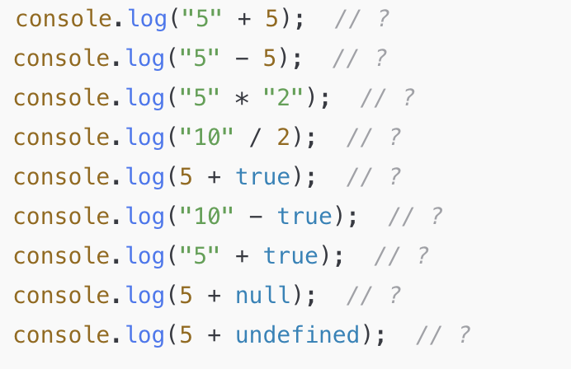
Practice
Challenge 1: Type Coercion Mystery
Challenge 2: Type Conversion Practice
Convert the string "200" into a number and add 50.
Convert the number 25 into a string and concatenate " years old".
Check if the boolean value of "false" (a string) is true or false.
Find the result of console.log("10" - true) and explain why.

Slide 12
Practice
Challenge 3: Temperature Converter
Declare a const for a temperature in Celsius.
Convert it to Fahrenheit using: F=(C×9/5)+32
Print both Celsius and Fahrenheit temperatures.
Check: What happens if you try to change the const value?
Bonus: Take the Celsius value from user input instead of a fixed number.
Challenge 4: Budget Calculator
Declare a let variable for your total budget.
Use prompt() to take the budget as input. Convert it to a number.
Take three expenses as inputs (all strings), then convert them to numbers.
Subtract expenses from the budget and check if the budget is negative.
Print a warning if the user has overspent.
Bonus: Format the output so it always shows two decimal places.

Slide 13
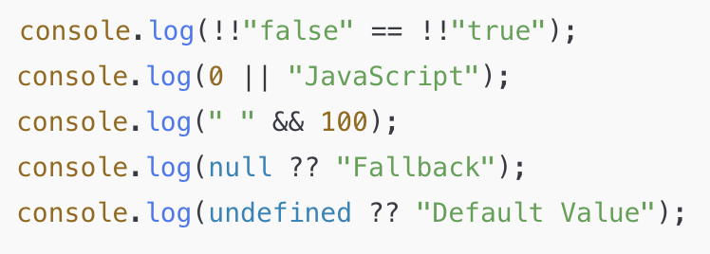
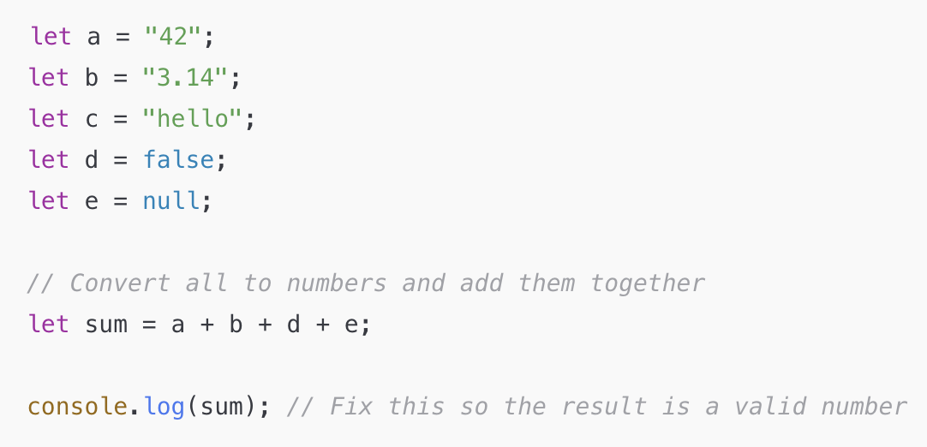
Practice
Challenge 5: Logical Coercion Trickery
Challenge 6: Convert Values Properly
Task: Modify the code so that sum contains the correct numerical total instead of string concatenation or unexpected results.

Slide 14
Thank You

